Slide 1
INTRODUCTION TO OBJECT ORIENTED PROGRAMMING IN C#-Part3

Slide 2
Objective
Types of relationships among classes - inheritance, aggregation and composition
Abstract classes
Interfaces

Slide 3
Different Types of Relationship
By analyzing the five point requirement given previously, we can easily visualize four relationships
Inheritance
Aggregation
Association
Composition
Notes:
Aggregation: Requirement 2 is an interesting requirement (Manager uses a swipe card to enter XYZ premises). In this requirement, the manager object and the swipe card object use each other but they have their own object life time. In other words, they can exist without each other. The most important point in this relationship is that there is no single owner.

Slide 4
Requirement 1: The IS A relationship
Inheritance:
If you look at the first requirement (Manager is an employee of XYZ limited corporation), it’s a parent child relationship or inheritance relationship.
The sentence above specifies that Manager is a type of employee, in other words we will have two classes: parent class Employee, and a child class Manager which will inherit from the Employee class.

Slide 5
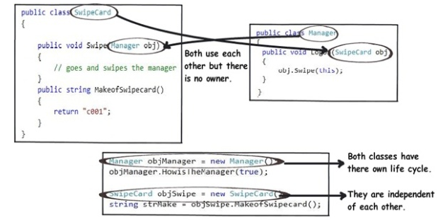
Requirement 2: The Using relationship: Association
Requirement 2 is an interesting requirement (Manager uses a swipe card to enter XYZ premises). In this requirement, the manager object and the swipe card object use each other but they have their own object life time. In other words, they can exist without each other. The most important point in this relationship is that there is no single owner.
Notes:
The above diagram shows how the SwipeCard class uses the Manager class and the Manager class uses theSwipeCard class. You can also see how we can create objects of the Manager class and SwipeCard class independently and they can have their own object life time.
This relationship is called the “Association” relationship.

Slide 6
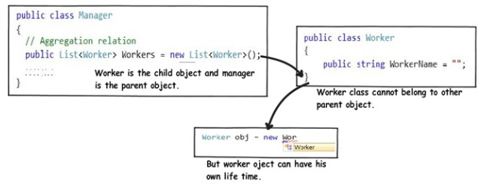
Requirement 3: The Using relationship with Parent: Aggregation
The third requirement from our list (Manager has workers who work under him) denotes the same type of relationship like association but with a difference that one of them is an owner. So as per the requirement, the Manager object will own Worker objects.
Notes:
The child Worker objects can not belong to any other object. For instance, a Worker object cannot belong to aSwipeCard object.
But… the Worker object can have its own life time which is completely disconnected from the Manager object. Looking from a different perspective, it means that if the Manager object is deleted, the Worker object does not die.
This relationship is termed as an “Aggregation” relationship.

Slide 7
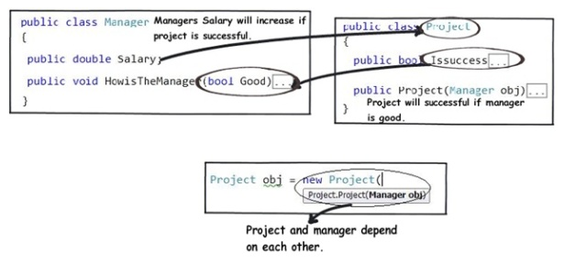
Requirements 4 and 5: The Death relationship: Composition
The last two requirements are actually logically one. If you read closely, the requirements are as follows:
Manager has the responsibility of ensuring that the project is successful.
Manager's salary will be judged based on project success.
Below is the conclusion from analyzing the above requirements:
Manager and the project objects are dependent on each other.
The lifetimes of both the objects are the same. In other words, the project will not be successful if the manager is not good, and the manager will not get good increments if the project has issues.
Notes:
You can also see that when the project object is created, it needs the manager object.
This relationship is termed as the composition relationship. In this relationship, both objects are heavily dependent on each other. In other words, if one goes for garbage collection the other also has to be garbage collected, or putting from a different perspective, the lifetime of the objects are the same. That’s why I have put in the heading “Death” relationship.

Slide 8
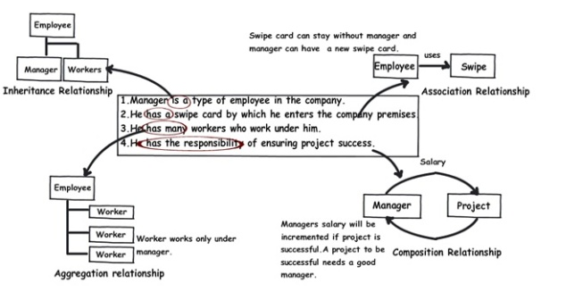
Putting Things Together

Slide 9
Inheritance in C#: Details
Inheritance is the ability to derive new classes from existing ones. A derived class ("subclass") inherits the instance variables and methods of the base class (“parent class"), and may add new instance variables and methods.
Inheritance defines a hierarchical relationship among classes wherein one class shares the attributes and methods defined in one or more classes.
Inheritance is a relationship among classes in which one class shares the structure and behavior of another. A subclass inherits from a base class.

Slide 10
Relationships of Inheritance
Inheritance specifies an “is a kind of" relationship
Inheritance is a class relationship
New classes specialize existing classes
Generalization
Musician
Base class
Specialization
Violin
Player
Derived class
Notes:
Note:
1. A derived class inherits most elements of its base class
2. A derived class cannot be more accessible than its base class

Slide 11
Class Hierarchies
Classes related by inheritance form class hierarchies
Musician
plays
Musical
Instrument
String
Musician
plays
Stringed
Instrument
???
Violin
Player
plays
Violin
???

Slide 12
Single and Multiple Inheritance
Single inheritance: deriving from one base class
Multiple inheritance: deriving from two or more base classes (multiple inheritance of classes is not supported in .NET, but multiple inheritance is provided through interfaces)
Stringed
Instrument
Musical
Instrument
Pluckable
Violin
Stringed
Instrument
Violin has a single direct base class
Stringed Instrument has two direct base classes

Slide 13
Example
Scenario:
Consider, in InfoSystem Ltd. Company, there are many categories of employees, such as, Junior Developer, Senior Developer, Project Manager, Human Resource Executive etc.
Problem:
Salary for them has to be calculated based on their salary structure, including basic payment, dearness allowance payment, hra payment
Solution:
Let’s represent them through different classes, such as SrDeveloper, JrDeveloper,ProjectManager etc., where all the classes will have same fields, such as, name, id, basic payment, dearness allowance payment, hra payment etc.
Since all the fields are common in derived classes, let’s create a base class Employee and put the common fields in the base class and derive other classes from the base class Employee

Slide 14
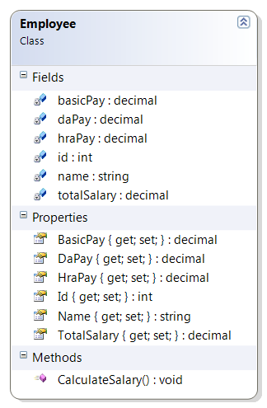
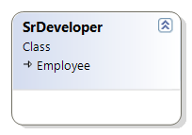
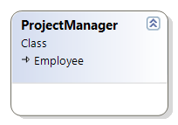
Class Diagram

Slide 15
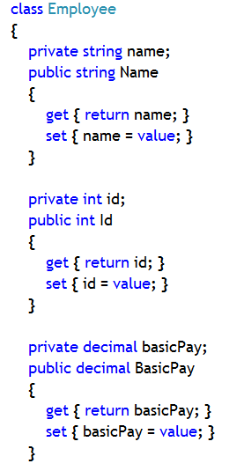
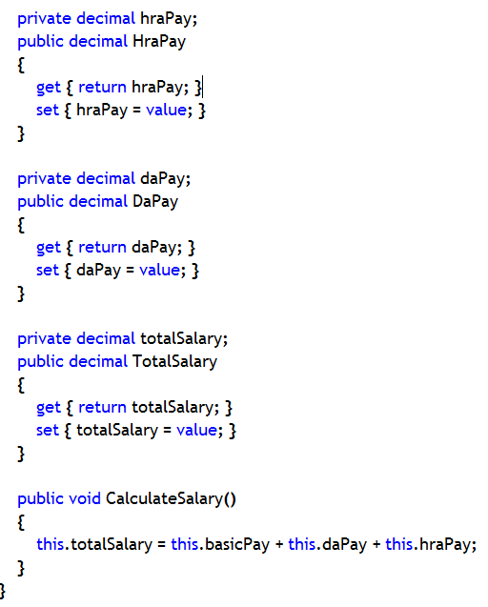
Employee class code

Slide 16
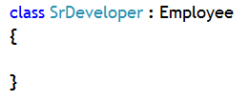
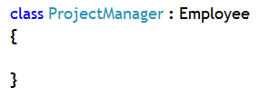
Derived class code

Slide 17
Parent/Child Conversions
Conversion to parent class reference (upcasting)
Implicit or explicit
Always succeeds
Can always assign to object
Conversion to child class reference (downcasting)
Explicit casting required
Will check that the reference is of the correct type
Will raise InvalidCastException if not

Slide 18
Up-casting and Down-casting
Upcasting is conversion up the inheritance hierarchy
Example: Employee employee = new SrDeveleoper();
Downcasting is conversion down the inheritance hierarchy
SrDeveloper developer =(SrDeveloper) new Employee();
Note: through ‘employee’ reference variable you can only call members of Employee class derived in the SrDeveloper class, not the explicit members of SrDeveloper class
“Upcasting”
Employee
“Downcasting”
SrDeveloper
ProjectManager

Slide 19
What is Abstract class and method?
When you want to create classes that will act as base class, but do not want to create object of that class, then you can make use of abstract keyword in C# to declare a class as an abstract class
An abstract class is the one, which has at least one abstract member
And, an abstract member is the one which does not have any code or implementation logic
Why?
Some classes exist solely to be derived from
It makes no sense to create instances of these classes
These classes are abstract classes

Slide 20
Declaring Abstract Class, Method and Property
Use the abstract keyword while declaring abstract method. Also, do not provide any implementation for that method
Use the abstract keyword while implementing abstract property. Also do not implement set and get accessors in a property
The class has to be declared with abstract keyword, too
abstract class Employee
{
public abstract void CalculateSalary();
public abstract decimal TotalSalary
{
set;
get;
}
//other abstract or
//non-abstract members
}
class Test
{
static void Main( )
{
Employee rajeshEmployee
=new Employee();
}
}
An abstract
class
cannot
be
instantiated
û

Slide 21
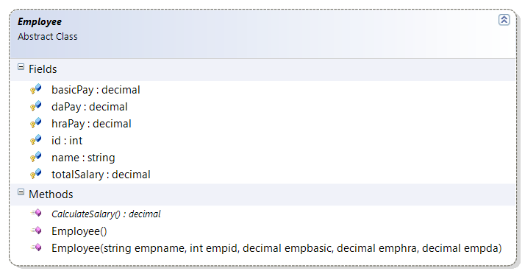
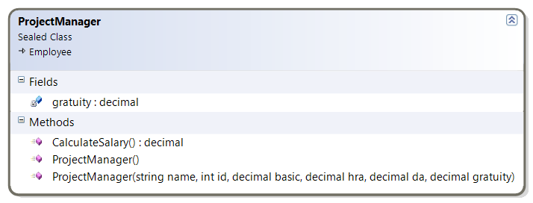
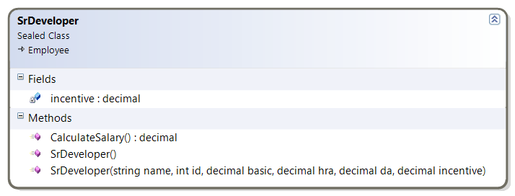
Example: Abstract Class
Class Diagram

Slide 22
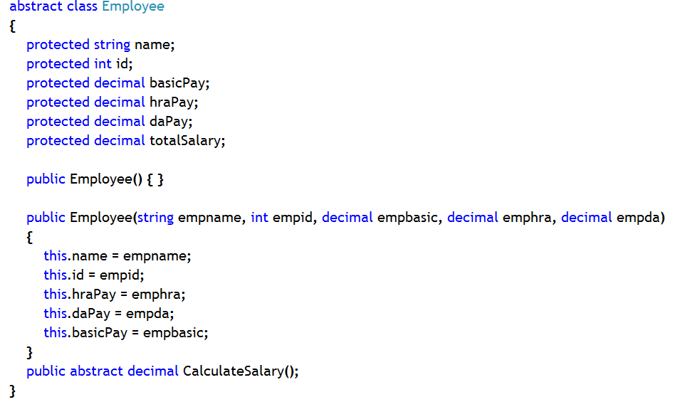
Example: Abstract Class
Employee class code

Slide 23
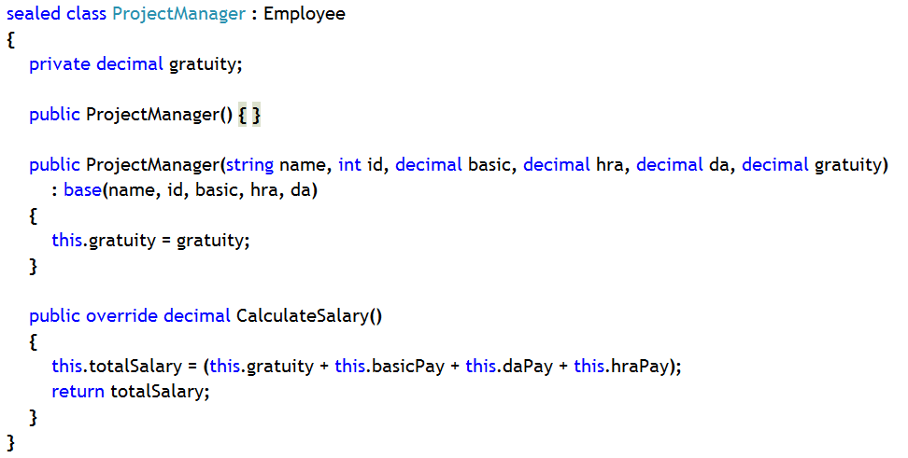
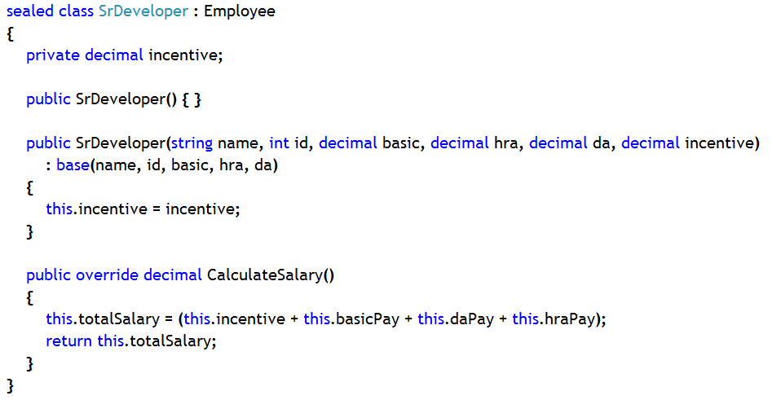
Example: Abstract Class
Derived class code
By default, abstract members are virtual. So, while implementing them in the derived class, one should use ‘override’ keyword

Slide 24
Important Points to Remember About Abstract
Abstract methods have to be implemented in the child class. Otherwise, child class will also become abstract class
Abstract methods/properties are by default virtual. So, while providing implementation in derived class you have to use ‘override’ keyword
Abstract class objects can’t be created
Abstract class variable can hold reference of child class objects (Upcasting)
Abstract class is basically used as a template for other classes. All members, that you want to implement differently in different child classes, should be declared as abstract members in an abstract base class

Slide 25
Interface
Interface is a pure abstract class. That means, all the members of an interface are pure abstract.
It does not contain any member with implementation
interfaces are for realization relationship.
A Realization is a relationship between two elements, in which one element (the client) realizes the behavior that the other element (the supplier) specifies.
Objects of interface can’t be created.

Slide 26
Example: Interface
Syntax: Use ‘interface’ keyword to declare an interface
Interface names should begin with a capital “I”
interface IToken
{
int LineNumber( );
string Name {get; set;};
}
IToken
« interface »
LineNumber( )
Name( )
No access specifiers
No method bodies

Slide 27
Interface Rules
Interface members are by default public and abstract , do not declare them with public and abstract keyword
Interface can’t contain fields or anything with an implementation
Interface can contain methods without implementation and properties with set and get accessors, but without implementation
Interface is a reference type, that means, an interface variable can hold reference of an object of a class that implements the interface
Multiple interfaces can be implemented in a class
Interface can inherit from an interface, but not from a class or any other non-interfaces types
If a class does not implement any of the members of an interface then the class has to be declared as an abstract class as well as the member which is not implemented, has to be declared as abstract member

Slide 28
Implementing Multiple Interfaces in a class
A class can implement zero or more interfaces
An interface can extend zero or more interfaces
A class can be more accessible than its base interfaces
An interface cannot be more accessible than its base interfaces
A class must implement all inherited interface methods
interface IToken
{
string Name( );
}
interface IVisitable
{
void Accept(IVisitor v);
}
class Token: IToken, IVisitable
{ ...
}
IToken
« interface »
IVisitable
« interface »
Token
« concrete »

Slide 29
Implementing Interface Members Implicitly
The implementing method must be the same as the interface method
The implementing method can be non-virtual or virtual
class Token: IToken, IVisitable
{
public string Name( )
{ ...
}
public void Accept(IVisitor v)
{ ...
}
}
Same access
Same return type
Same name
Same parameters
public virtual string Name( )
{ ...
}

Slide 30
Calling interface methods
Calling interface methods Implicitly
Calling interface Explicitly
Token tokenobject = new Token();
Tokenobject.Name();
Token class object
created and method
is being called through
the object reference
Token class object
created and then reference
is passed to a variable of
the interface and through
that reference variable method
is being
Token tokenobject = new Token();
IToken itocken = tokenobject;
itocken.Name();
Notes:
Note: If you implement a member of an interface in a class implicitly, you can call that member implicitly or explicitly, i.e., using nay of the ways.

Slide 31
Interface in an Hierarchy
IMusician is an interface with PlayMusic() method, which is not implemented in Musician class, but implemented in derived class ViolinPlayer
IMusician
void PlayMusic();
« interface »
Interface: Nothing but operations.
You cannot create instances of an interface.
Abstract Class: May contain some
implementation. You cannot create instances of an abstract class.
Musician
public abstract void PlayMusic();
{ abstract }
Derived Class: Must implement all
inherited operations. You can create instances of a concrete class.
Violin Player
public override void PlayMusic(){ //code}
« concrete »

Slide 32
Reference
http://www.codeproject.com/Articles/330447/Understanding-Association-Aggregation-and-Composit
For more information on interfaces, please visit the following link
http://msdn.microsoft.com/en-us/library/ms173156.aspx
For more information on polumorphism, please visit the following link
http://msdn.microsoft.com/en-us/library/ms173152.aspx
For more information on abstract class, please visit the following link
http://msdn.microsoft.com/en-us/library/ms173150.aspx
Notes:
Reference

